Slide 1
Tesfa Program
Toolkit Project
Hope in a time of uncertainty

Slide 2
COO Project Theory of Change
Providers, Organizations, Institutions
Ethiopian Community Members
Improving Outcomes
Input...
Stories
Best practices
Research
Improved…
Community power
Visibility of community assets and needs
Access to services
Quality of services
Better health for the Amharic speaking community!

Slide 3
Methods of story collections
Collecting evidence from community members
Analysis of community conversations/weekly
Podcast interviews with community members
Survey with Amharic speakers
Collecting evidence and stories from providers & organizations
Interviews with Ethiopian led CBOs
Interviews with PH and SS Providers
Tesfa Program volunteers feedback/lessons learned

Slide 4
Recommendations: 3 Tracks
Direct Service Providers
Decision Makers
Organizations
Today!

Slide 5
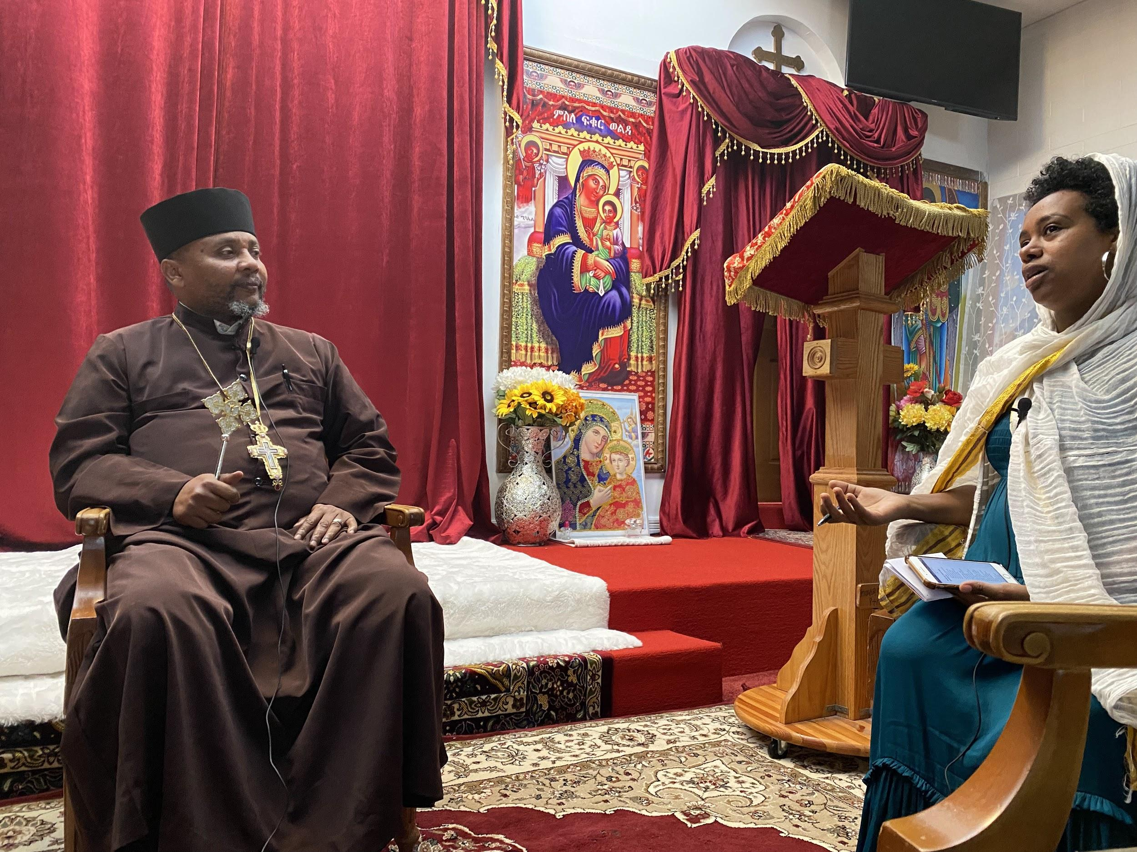
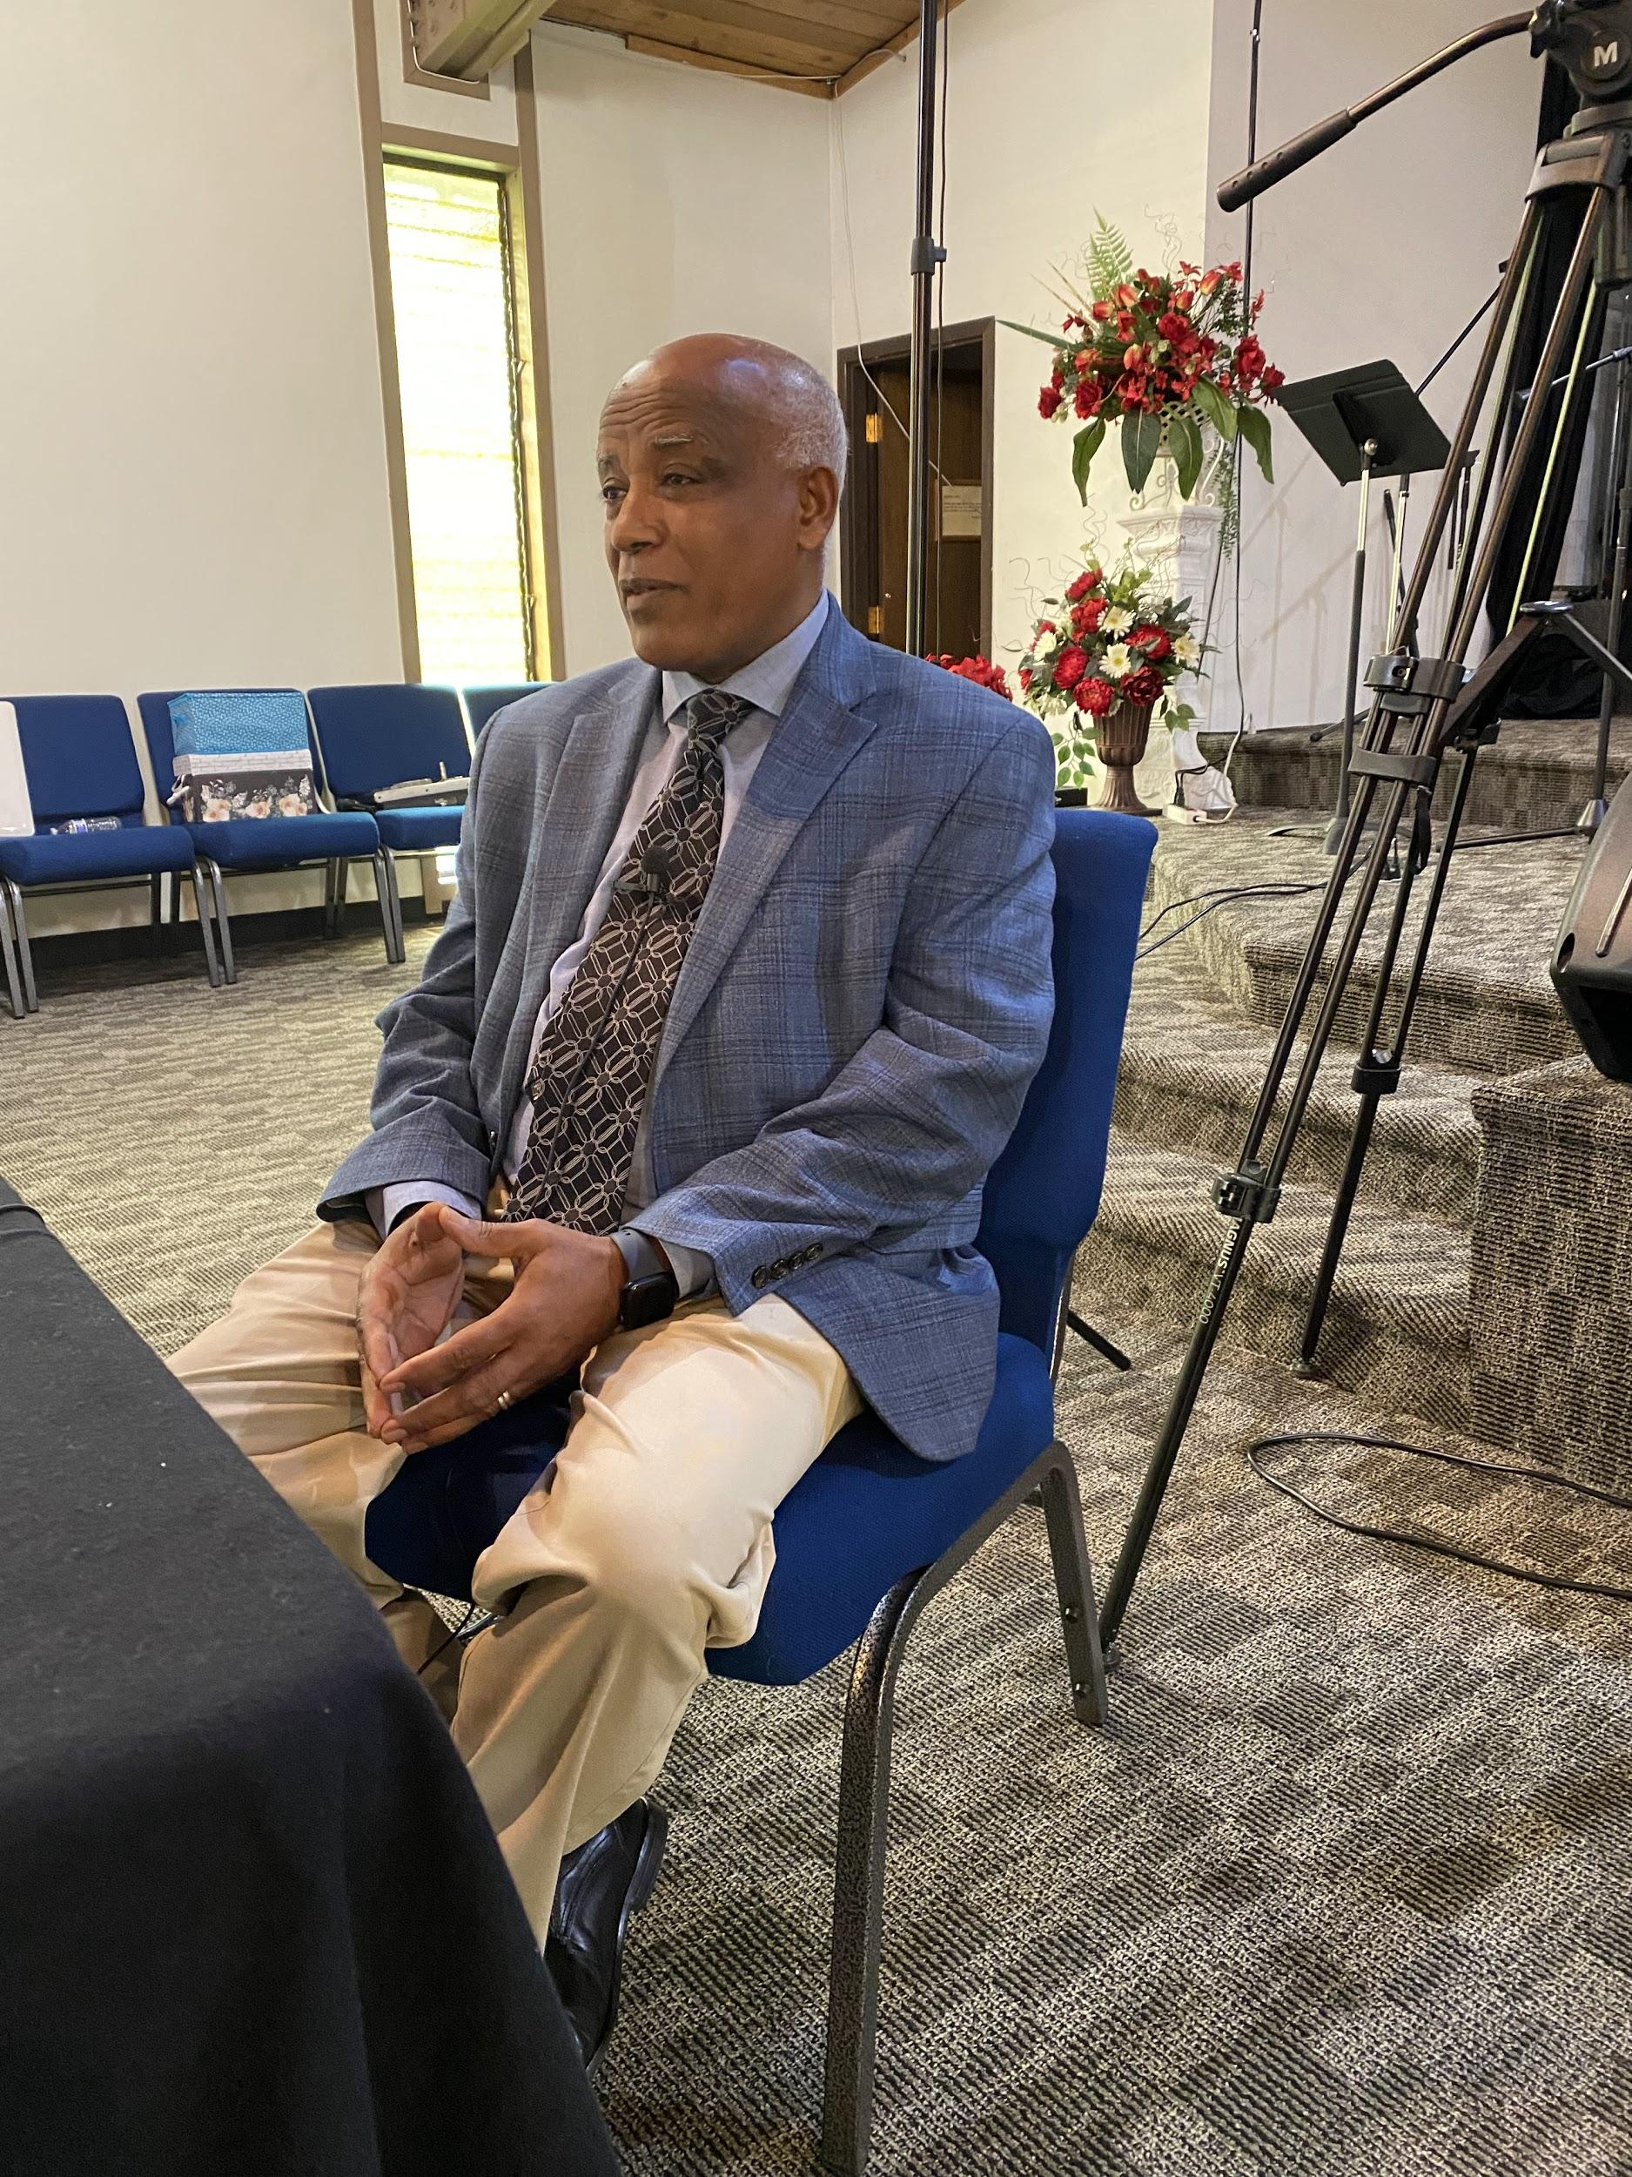
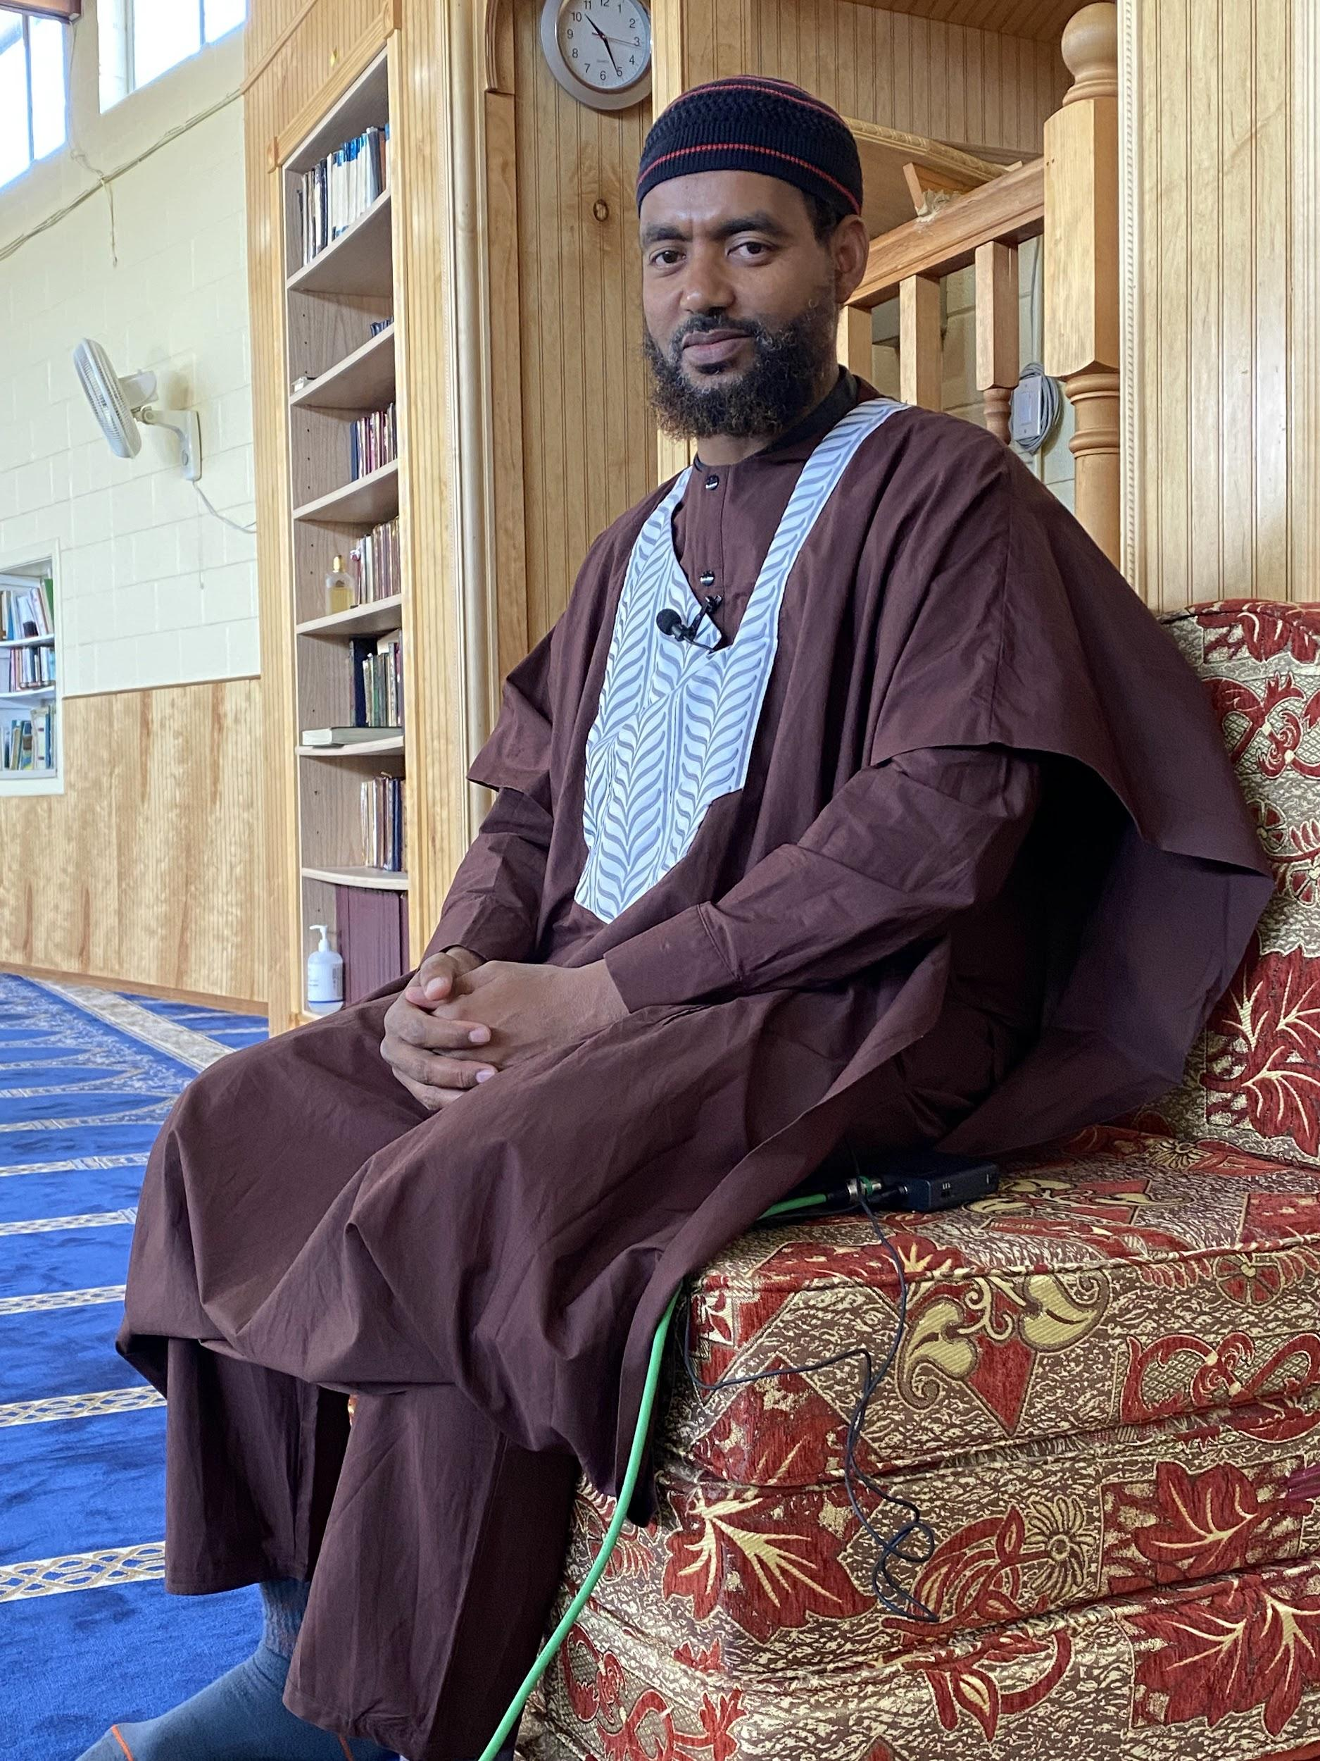
Highlight #1 Influence of Faith Leaders

Slide 6
Highlight #2
Social Media Considerations-
Turn off auto-translate on social media platforms...
Double check regularly that it is still turned off!

Slide 7
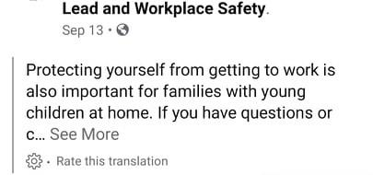

Slide 8
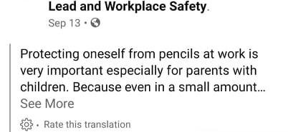

Slide 9
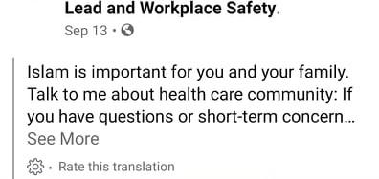

Slide 10
Organization Highlight #3
When Targeted Marketing Leads to Distrust

Slide 11
“Why is this vaccine clinic only for Black people?”

Slide 12
Lots of Other Topics Will Be Discussed in Our Toolkit…

Slide 13
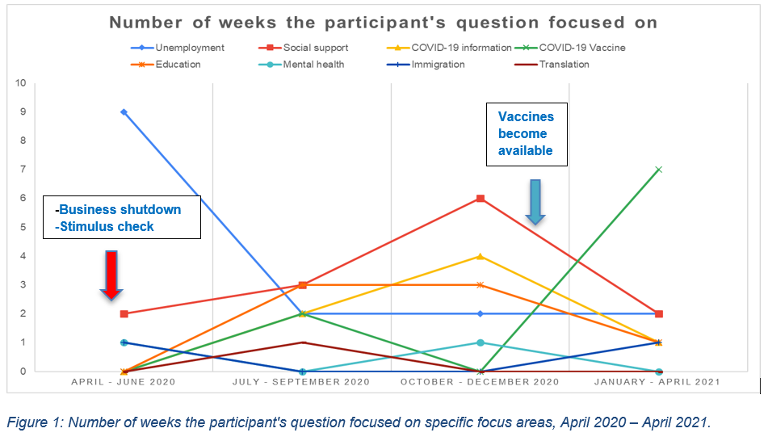
Including…
Unemployment
Translation
Digital Equity
Misinformation
Cultural Norms

Slide 14
Web-Based Toolkit Launching March 2022
Stories- 8 Podcast Episode Series
3 Tracks- Evidence-Based Outreach Best Practices
Research- Data Summaries

Slide 15
Questions/Comments

Slide 16
Podcast Trailer

